Slide 1
King County Housing Prices Prediction
Prepared by: DSF-PT7 Group 17
Agatha Nyambati
Mary Musyoka
Phoebe Wawire
Shamla Araya
Zenah Biwott

Slide 2
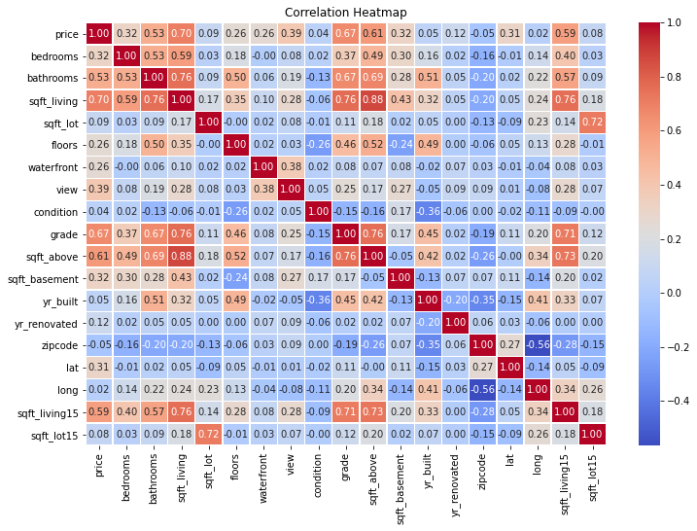
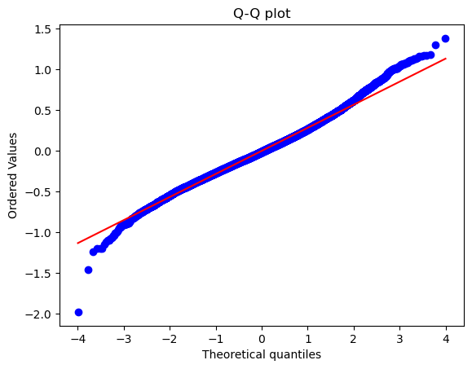
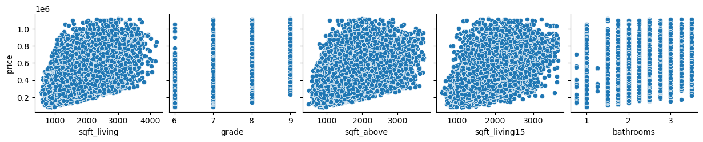
Summary
King County, located in the state of Washington, encompasses a diverse range of urban, suburban, and rural communities, including the city of Seattle. The housing market in King County has been characterized by rapid growth, high demand, and escalating prices over the past decade, influenced by factors such as population growth, economic prosperity, and limited housing supply.
The King County Housing Price Prediction Project is an initiative aimed at accurately forecasting housing prices in King County, Washington. This project leverages advanced data analytics and machine learning techniques to provide precise and actionable insights into the factors influencing housing prices in the region. By analyzing historical data and current market trends, we aim to develop a robust predictive model that can assist homebuyers, sellers, real estate agents, and policymakers in making informed decisions.

Slide 3
Outline
Business Problem
Data
Methods
Results
Conclusions

Slide 4

Business Problem
King County faces a significant housing crisis characterized by high demand and limited supply. Rapid population growth, driven by the area's strong job market, particularly in the tech sector, has led to increased housing prices and rental rates. Many residents struggle with affordability, resulting in a growing number of households experiencing housing insecurity or homelessness. Efforts to address the crisis include increasing housing development, implementing affordability measures, and expanding support services for low-income and homeless populations.
This project aims to provide tangible support by achieving the following objectives:
1: Identify key factors influencing housing prices in the region.
2: Provide a valuable Exploratory Data Analysis (EDA) for stakeholders such as homebuyers, sellers, real estate professionals, and policymakers to make informed decisions regarding property transactions and urban planning.
3: Develop a machine learning model to accurately predict housing prices based on property features, location, and market conditions.

Slide 5

Data
The dataset we are using for this project is from Kaggel website. This dataset contains more than 21,000 rows and 21 columns which describe or quantify the different aspects of the housing situation in the region. These features are crucial for achieving the objectives stated above.
We will load the data, clean it, run EDA and develop a model from it.

Slide 6

Methods
For this project, we will follow the following steps:
1. Load the dataset.
2. Data cleaning where we will check for missing values and any limitations within the dataset and prepare the dataset.
3. Data exploration where we will clearly identify all the features and select the ones we are willing to work with.
4. Analysis of the data to come up with insights that we can learn about the housing situation in the region
5. Preparing the data for machine learning models to predict the housing prices given different variables.

Slide 7

Results
After examining, cleaning, and analyzing the data, we have come with the following results:
Housing prices in King County are highly influenced by the living space, the grade, and the number of bathrooms.
Performed EDA that reveals the strong correlation between housing price and living space, grade and bathrooms. Stakeholders can get insights and make data-driven decisions regarding property transactions and urban planning based on this EDA.
Developed and trained a predictive model that can predict the housing price by about 70% accuracy with a mean absolute error (MAE) of 0.2 given a number of features.

Slide 8

Conclusions
Based on the result of the analysis, we recommend the following:
Influential Features: House price in King county is primarily influences by the total footage of living space, the grade and the number of bathrooms.
Market Insights: The EDA reveals that the King County housing market is significantly influenced by the total footage of living space. Even though the grade and number of bathrooms have a dictating influence on the price as well, Stakeholders should primarily pay attention at the total footage of living space for data-driven decisions in property transactions and urban planning.
Model Selection: The best model for predicting housing prices in King County is Model 4, which has an R-squared value of 0.7063 and a low Mean Absolute Error (MAE) of 0.2194. This model explains 70.63% of the variance in logarithmically transformed house prices and has the lowest prediction error, effectively capturing the mean and standard deviation of the transformed prices.

Slide 9
Thank You!

